Slide 2
Mike Moser
35 years in the automotive industry
Service Manager, auto & truck
Sales, engine diagnostic equipment
Fleet Management, 4500 assets operating in 23 States & Canada
Greater Rochester Clean Cities Board Member, 15 years
Principle, Moser Services Group, LLC 2011 - present

Slide 3
Largest EV charging
equipment distributor
in North America
Manufacturer of
EV charging
equipment

Slide 4
When it started…
It’s hard to pinpoint the invention of the electric car to one inventor or country. Instead, it was a series of breakthroughs -- from the battery to the electric motor -- in the 1800s that led to the first electric vehicle on the road.

Slide 5
Electric Vehicle Types
Hybrid
Plugin Hybrid Electric Vehicle (PHEV)
Battery Electric Vehicle (BEV)

Slide 6
Typical (Electric) Range
Hybrid – None, Start/Stop Technology, Acceleration Boost
PHEV – 10 to 50 miles
BEV – 100 to 400 miles

Slide 7
Is an EV right for me?
First or second vehicle?
Can I charge at home? At work?
What is my required range?
How often do I travel out of range?
Is there another vehicle I can use for trips?
Are there charging facilities along my route?

Slide 8
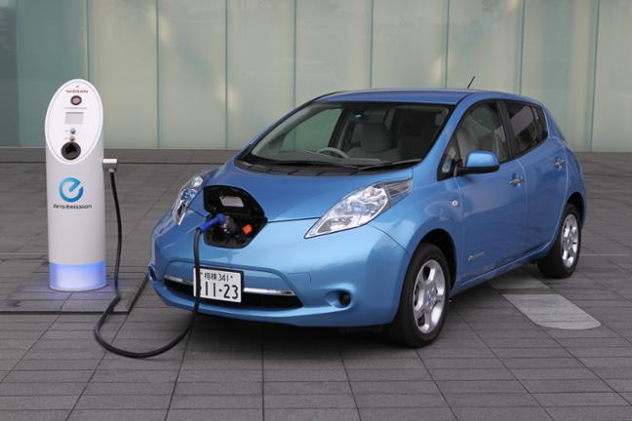
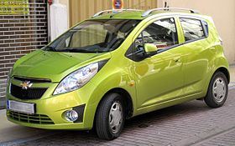
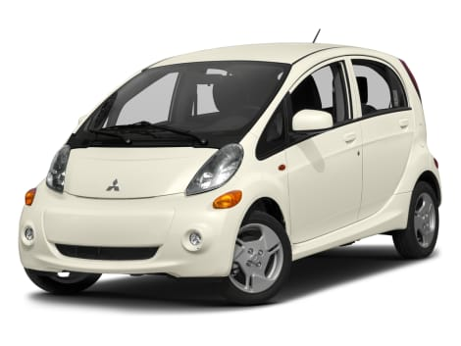
But EV’s are ugly!

Slide 9
PHEV’s available today

Slide 10
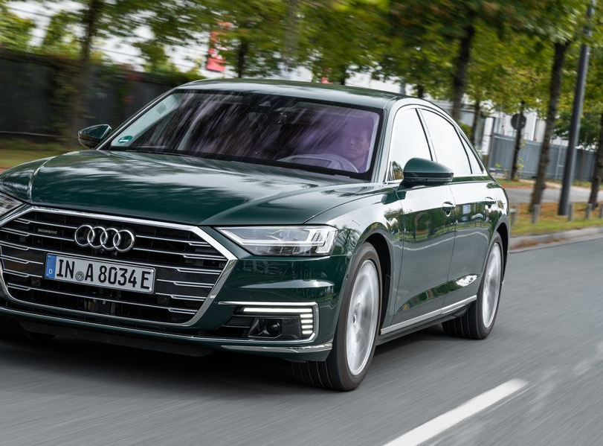
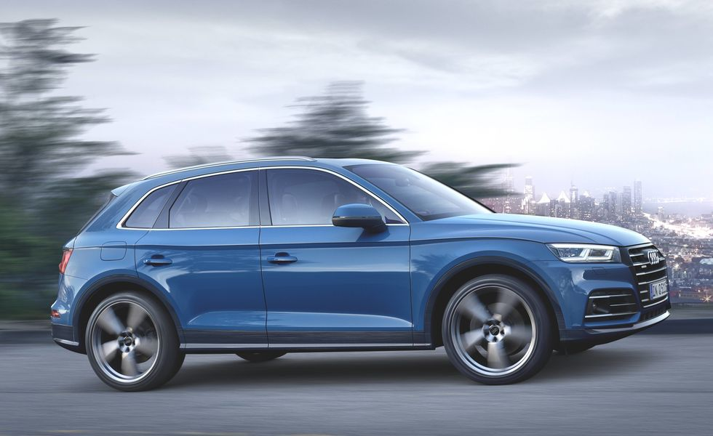
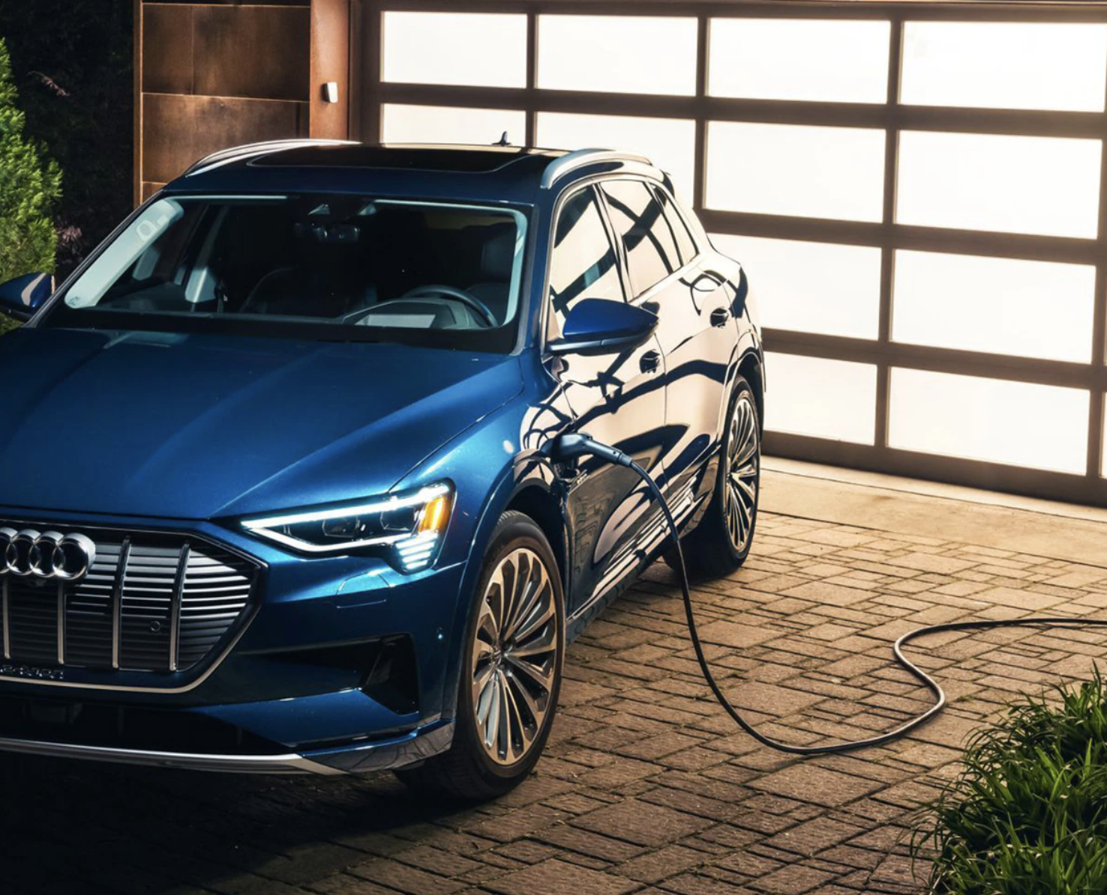
Audi
Audi A3 E-Tron
Audi Q5 TFSI e
Audi Q5 TFSI e

Slide 11
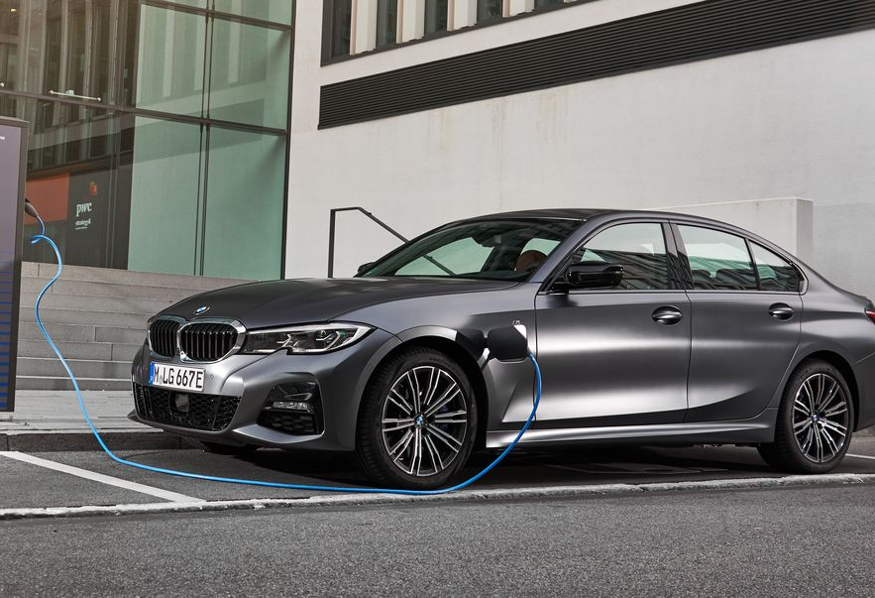
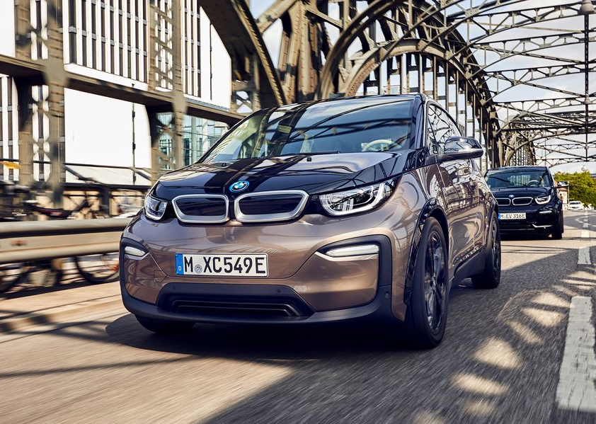
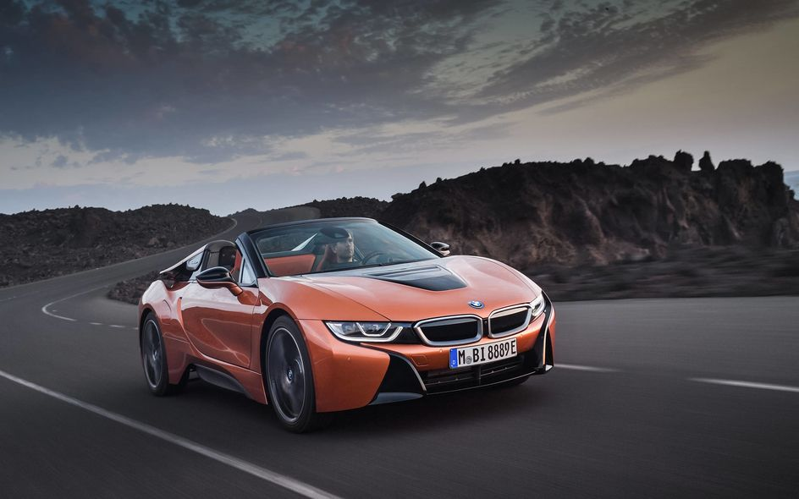
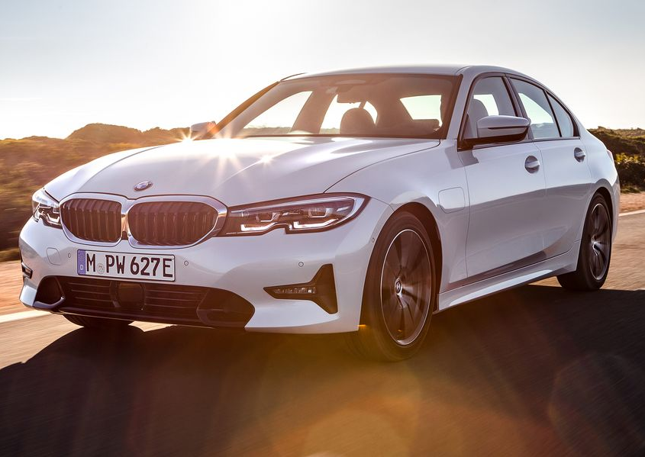
BMW
BMW 330e
BMW i3
BMWi8
BMW 530e xDrive
BMW 745eBMW 745e

Slide 12
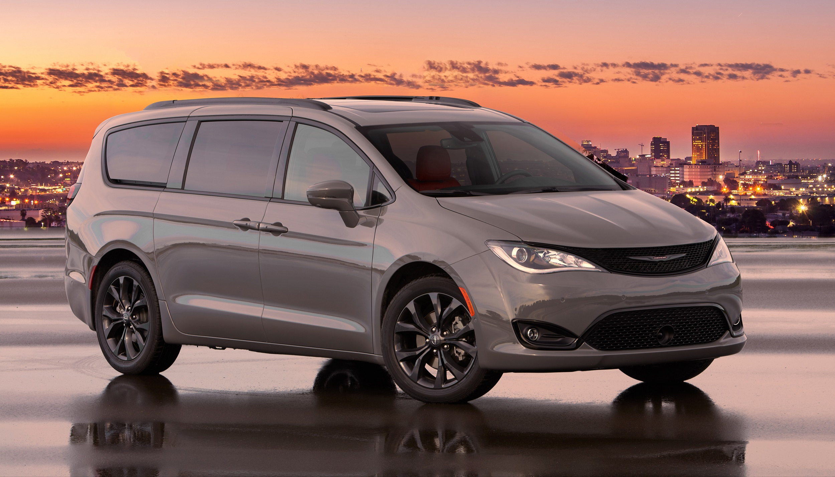
Chrysler Pacifica

Slide 13
Ford Fusion Energi

Slide 14
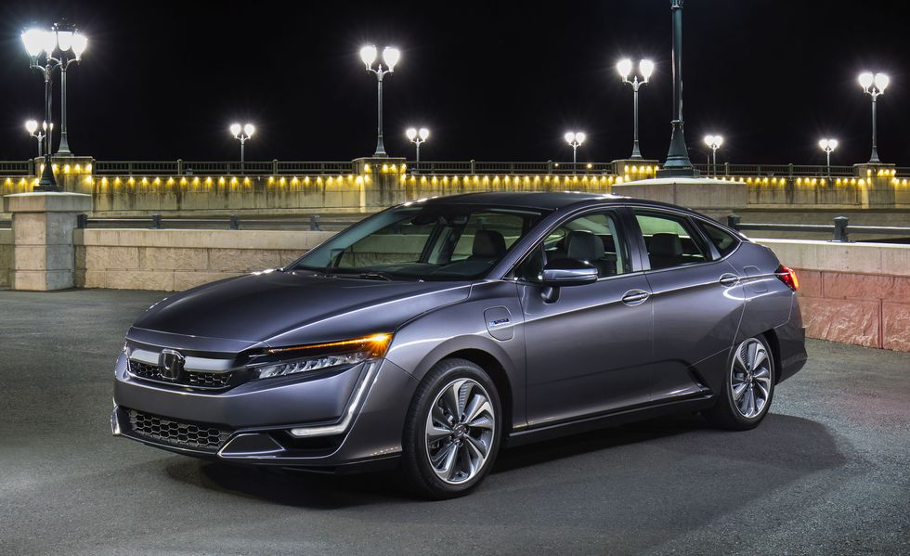
Honda Clarity Plug-In Hybrid

Slide 15
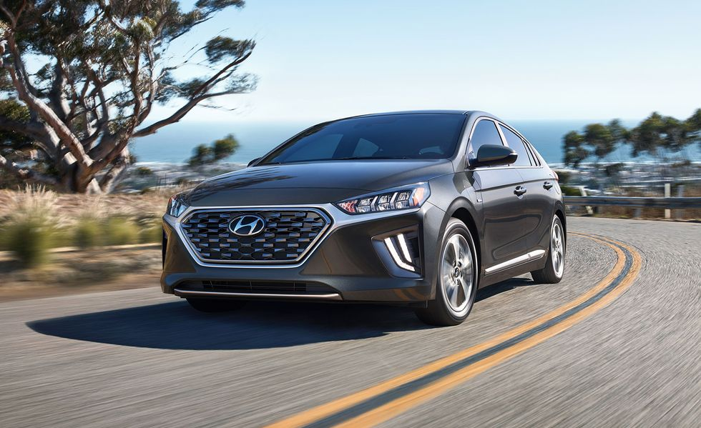
Hyundai Ioniq Plug-In Hybrid

Slide 16
Jeep Wrangler, Compass, Renegade 4XE

Slide 17
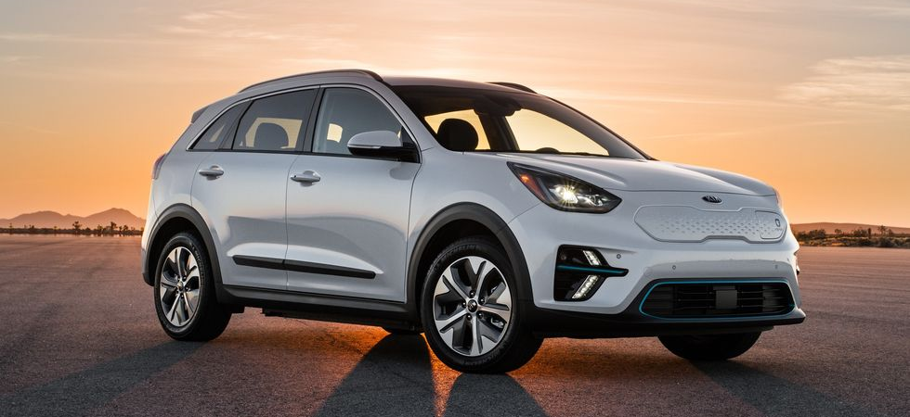
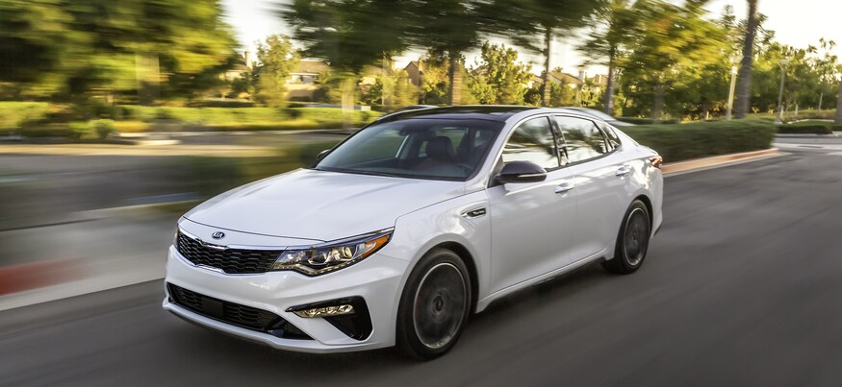
Kia Optima Kia Niro PHEV

Slide 18
Polestar 1

Slide 19
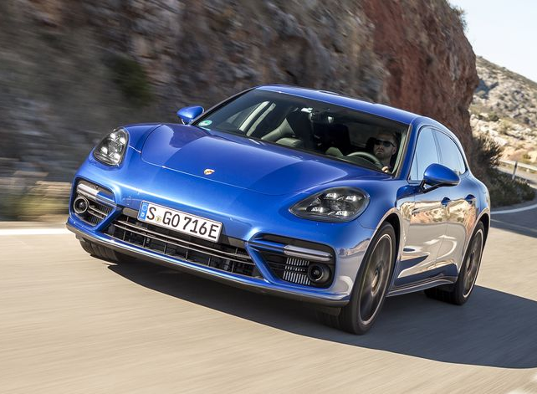
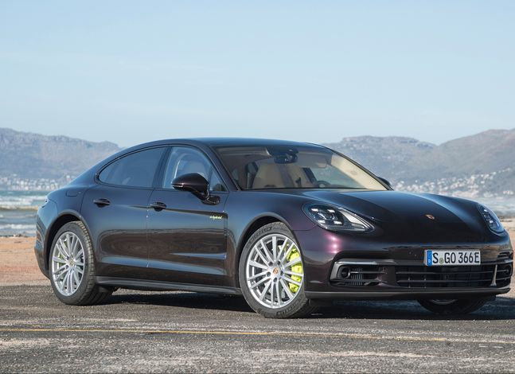
Porsche Cayenne S E-Hybrid Porsche Panamera / Panamera Sport Turismo 4 E-Hybrid Porsche Panamera Turbo / Panamera Sport Turismo Turbo S E-Hybrid

Slide 20
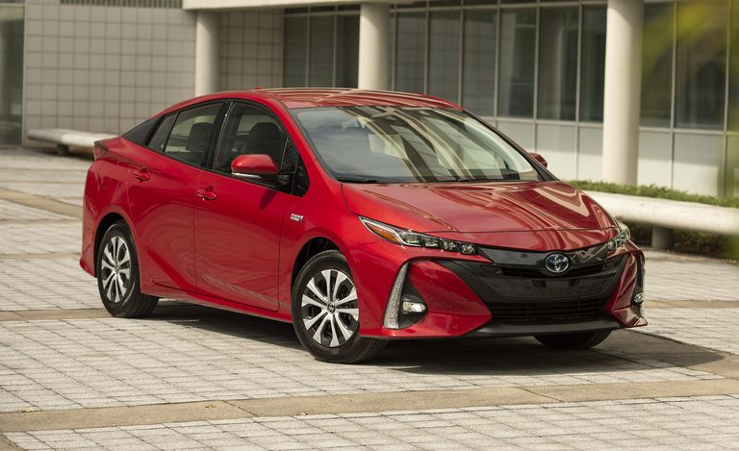
Toyota Prius Prime Toyota RAV4 Prime

Slide 21
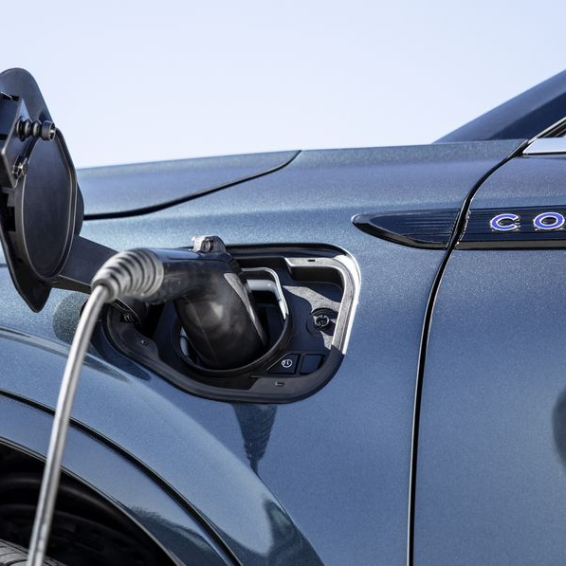
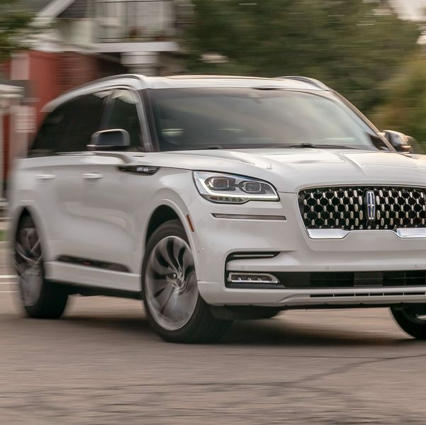
Lincoln Aviator Grand Touring Lincoln Corsair Grand Touring

Slide 22
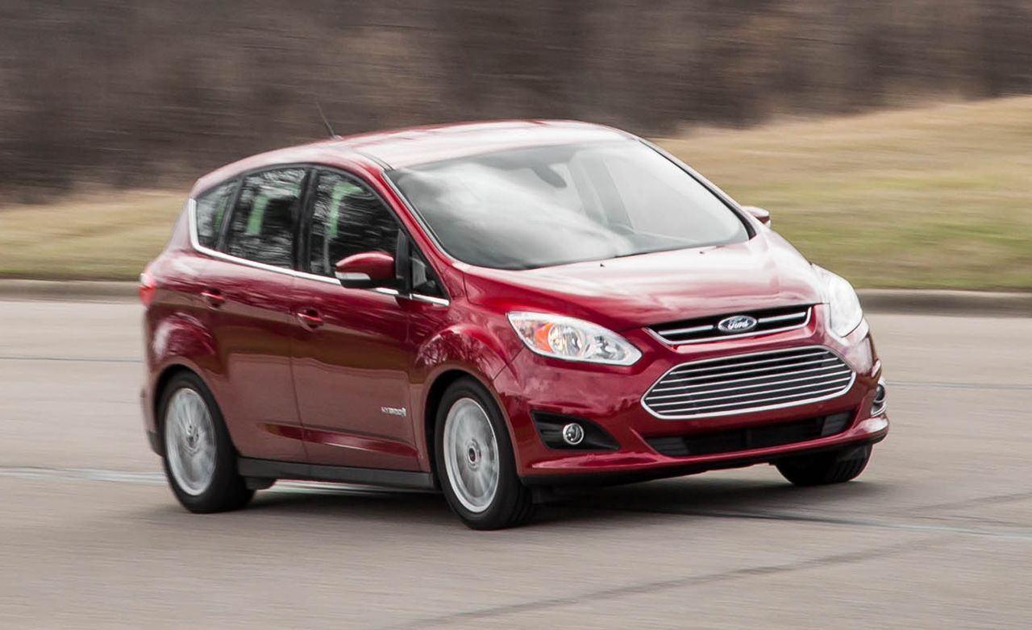
Ford C-Max Energi

Slide 23
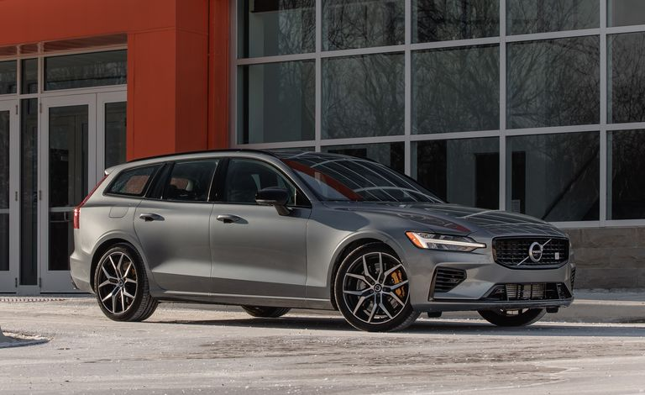
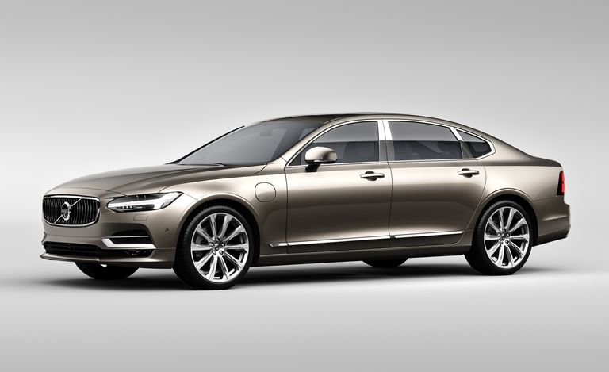
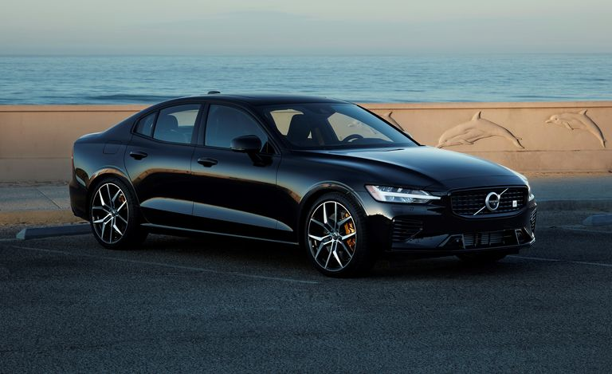
Volvo S90 T8 Plug-In Hybrid Volvo V60 T8 Polestar Volvo XC60 T8 Polestar Volvo XC90 T8 Plug-In Hybrid

Slide 24
Available BEV’s

Slide 25
Chevrolet Bolt EV

Slide 26
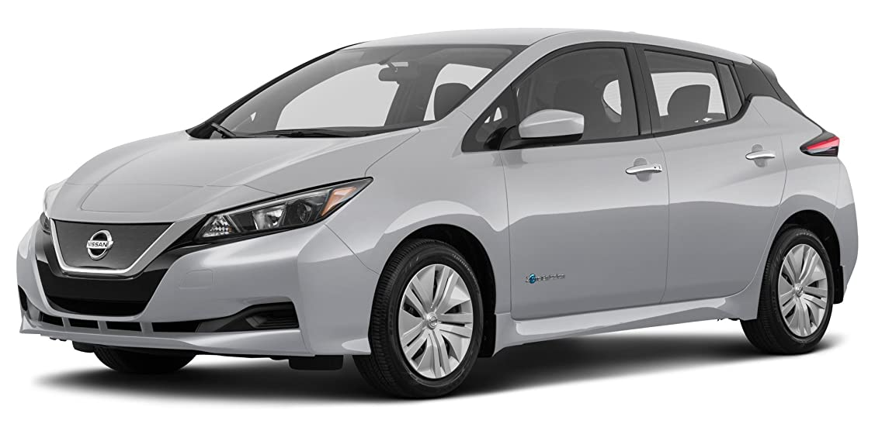
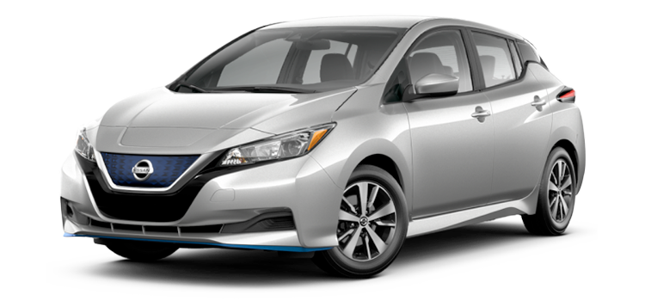
Nissan LEAF S Nissan LEAF S PLUS

Slide 27
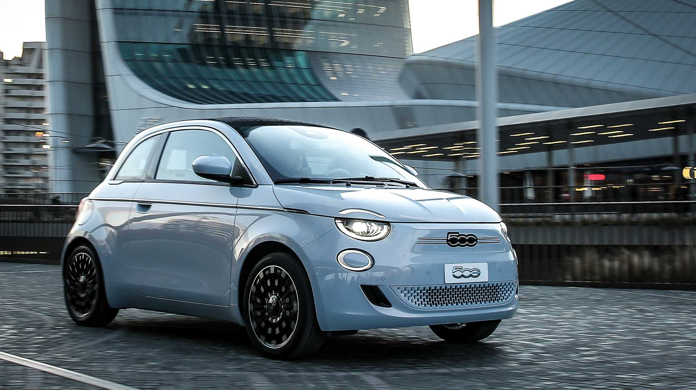
Fiat 500e

Slide 28
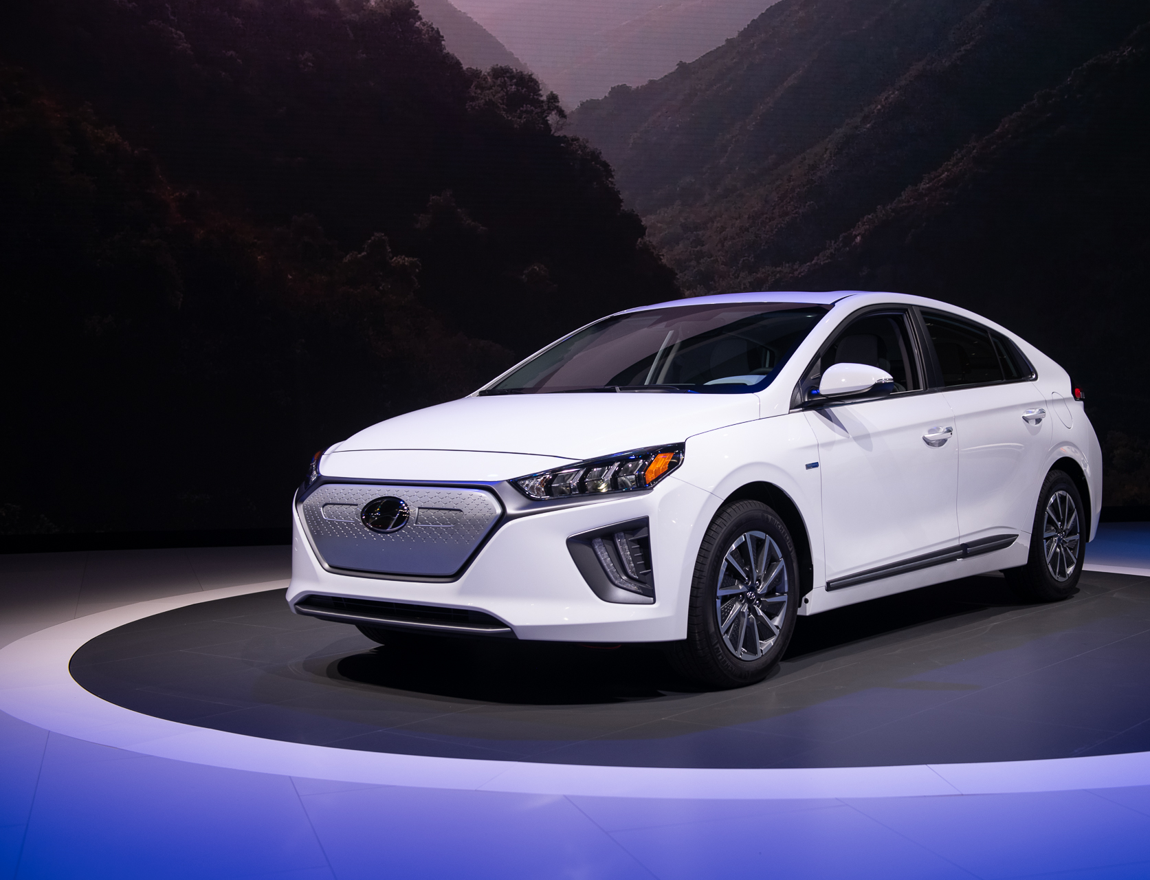
Hyundai IONIQ Electric Hyundai Kona Electric

Slide 29
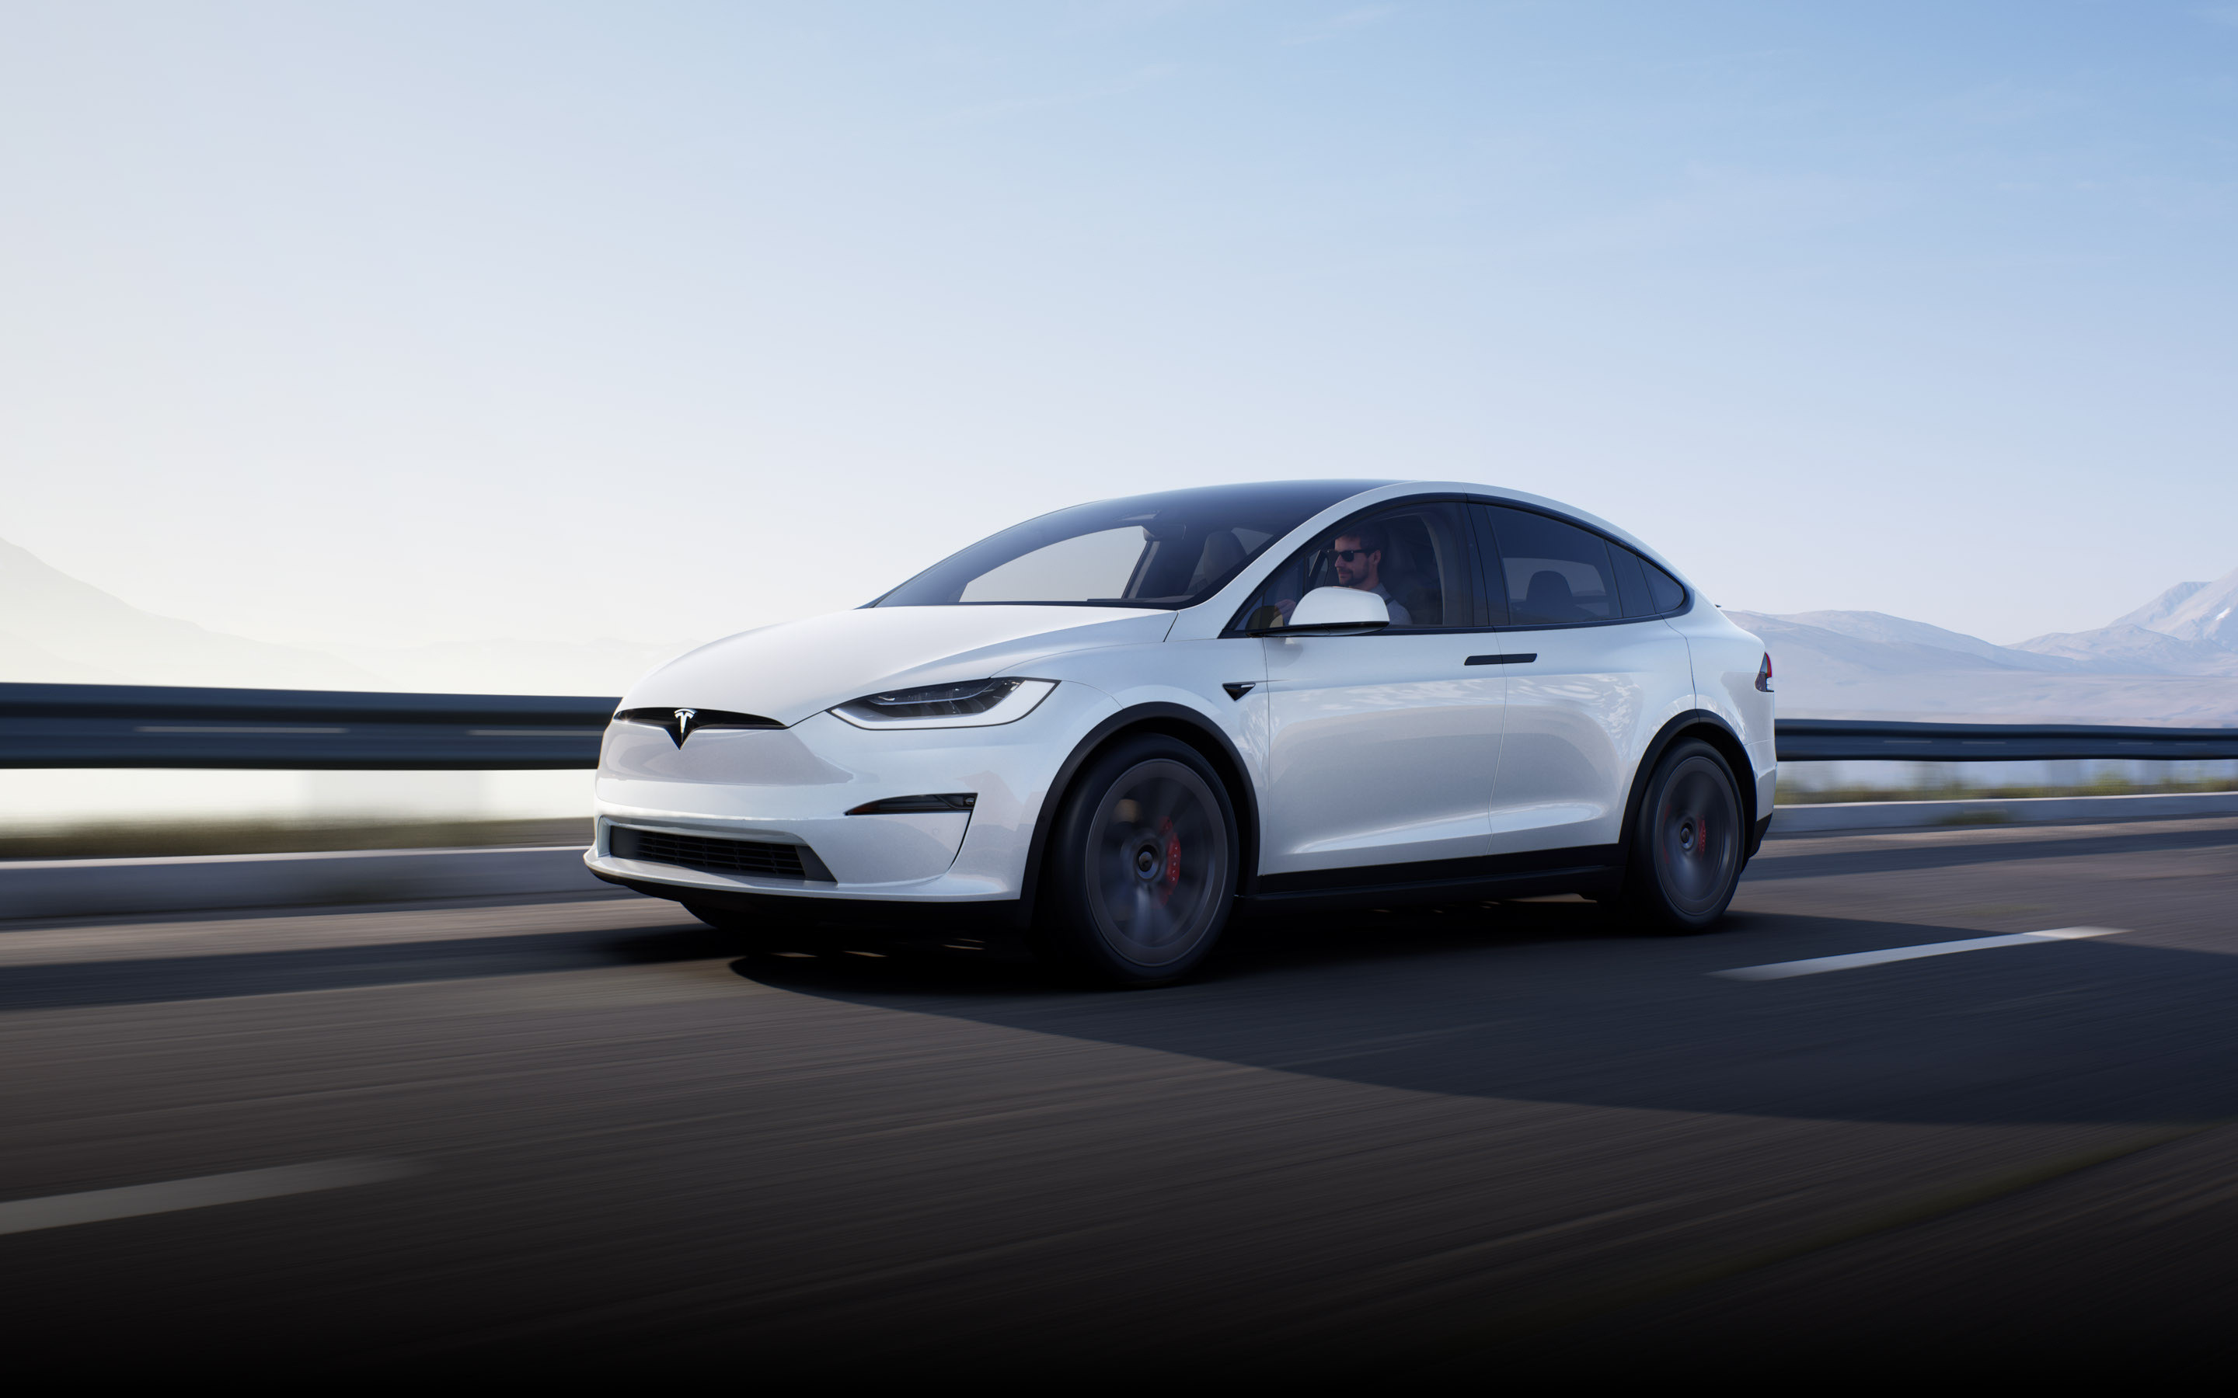
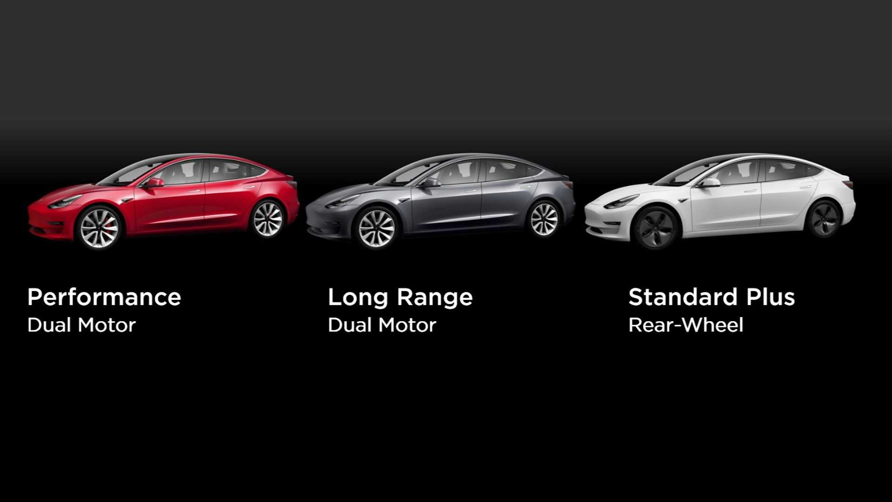
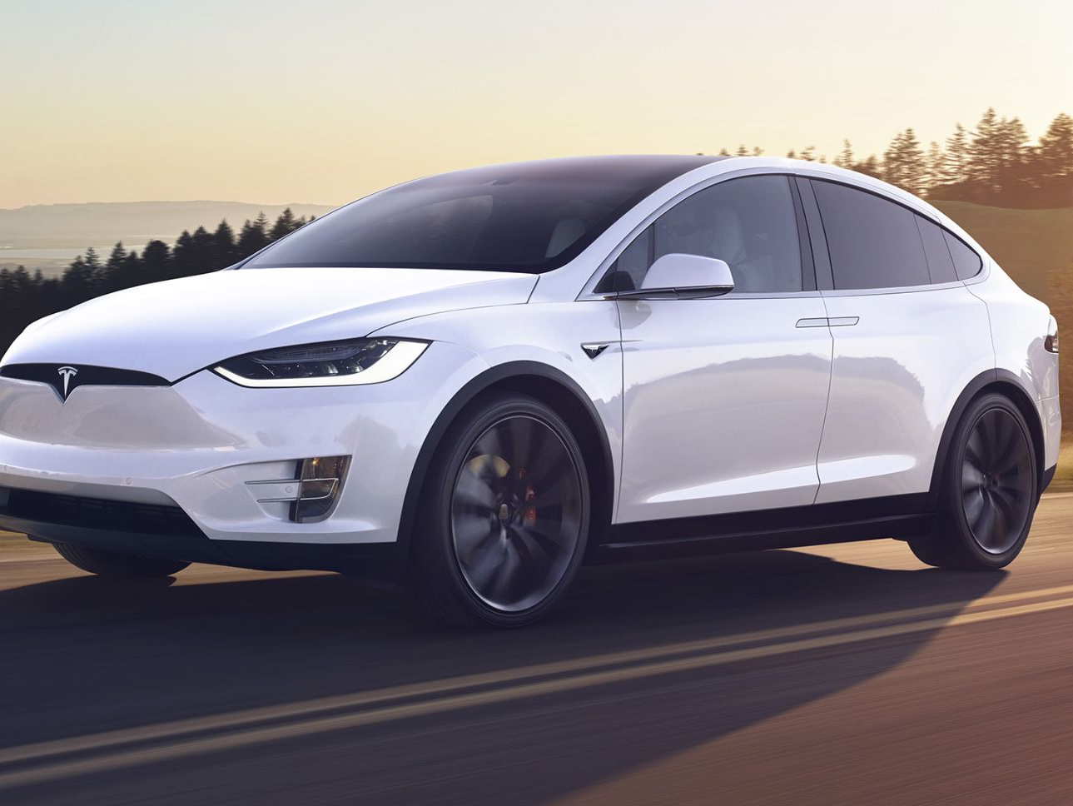
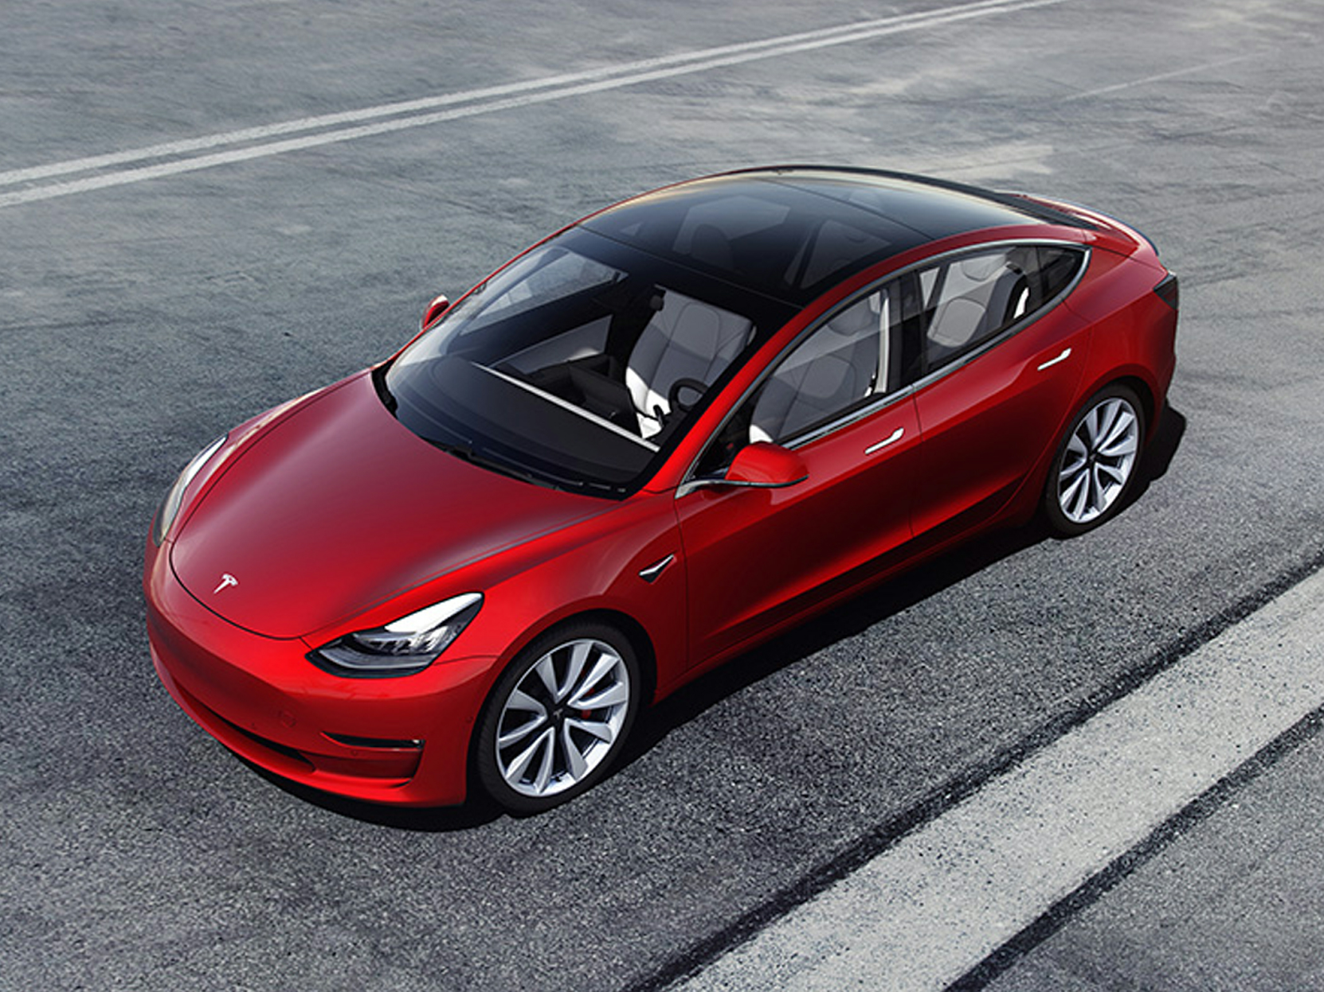
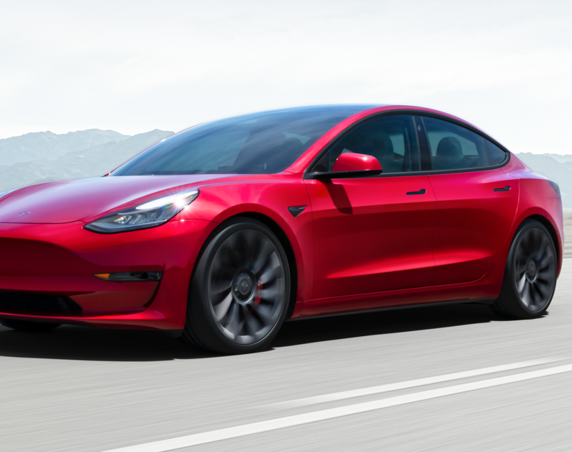
Tesla

Slide 30
Kia Niro Electric

Slide 31
BMW i3

Slide 32
Ford Mustang Mach-E California Route 1

Slide 33
Coming soon…
PHEV’s & BEV’s that will become available in the next ~2 years.
Mercedes-Benz EQS (2021)
Lotus Evija (2021)
Lordstown Endurance (2021)
Lucid Air (2021)
Nissan Ariya (2021)
Pininfarina Battista (2021)
Rivian R1S / R1T (2021)
BMW i4 (2022)
Cadillac Lyriq (2022)
Chevrolet Corvette EV (2022)
Ford F-150 Lightning (2022)
GMC Hummer EV (2022)
Land Rover Road Rover (2022)
Maserati MC20 EV (2022)
Porsche Macan EV (2022)
Tesla Roadster (2022)
Tesla Cyber Truck
Volkswagen ID.Buzz (2022)
Audi A6 E-Tron (2023)
Cadillac Celestiq (2023)
Canoo Pickup Truck (2023)
Cadillac "Electralade" (2023)
Canoo Pickup Truck (2023)
Chevrolet / GMC EV Pickup Trucks (2023)
Chevrolet Corvette SUV (2023)
Mercedes-Benz EQG-Class
Polestar Precept (2023)

Slide 34
Where can I charge my EV?
Home
Workplace
Public Level 2 Charger
Municipal
Private Business
Public Level 3 Charger

Slide 35
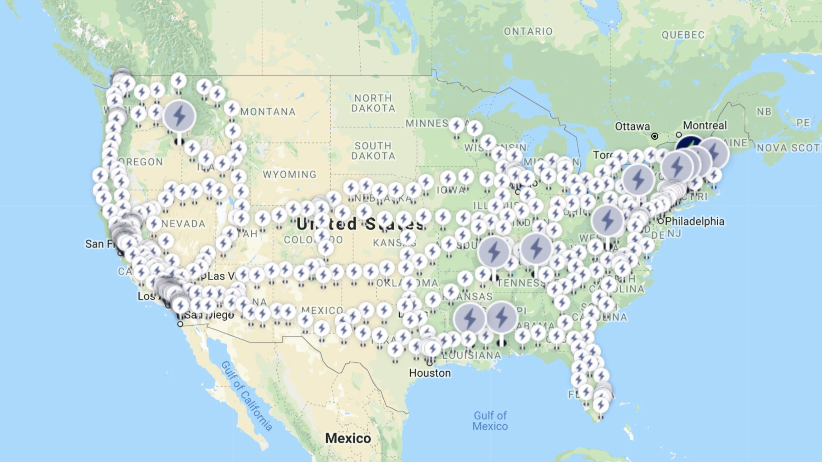
Electrify America Network
Result of VW’s Penalty

Slide 36
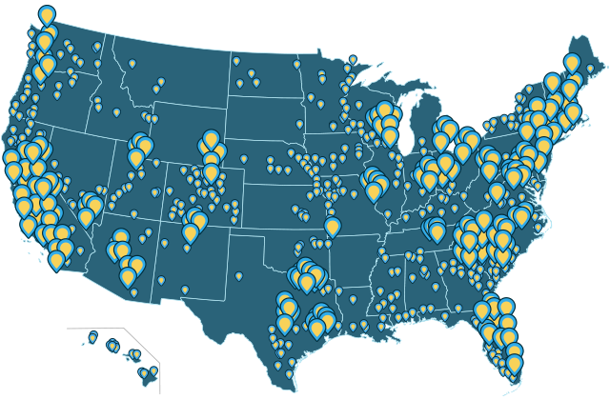
Evgo Network

Slide 37
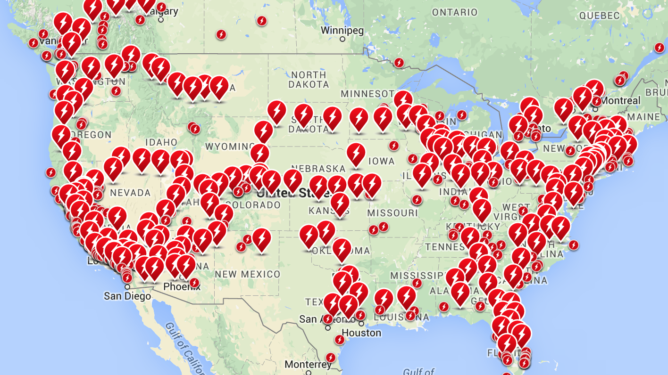
Tesla
Supercharge Network

Slide 38
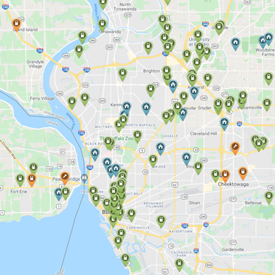
Western New York
PlugShare.com is the most common EVSE locator site.
Posted by station owners and EV drivers.
Photos and reviews

Slide 39
EV Charging 101
Level 1 – 120-volt household current (~3 to 5 MRPH)
Travel cord comes with passenger vehicles
Level 2 – 240-volt, 15-to-80-amp output (~15 to 60 MRPH)
Residential & Commercial applications
30-to-40-amp output most common
Level 3 – 480-volt / 3-phase commercial power
Only BEV’s are capable (one exception)
Not for daily use
For optimum battery life, charge as slow as your lifestyle permits.

Slide 40
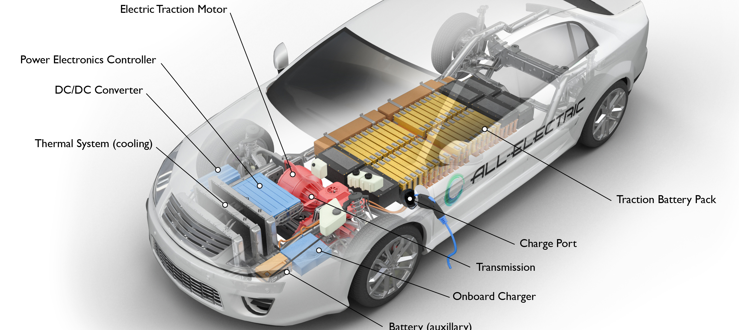
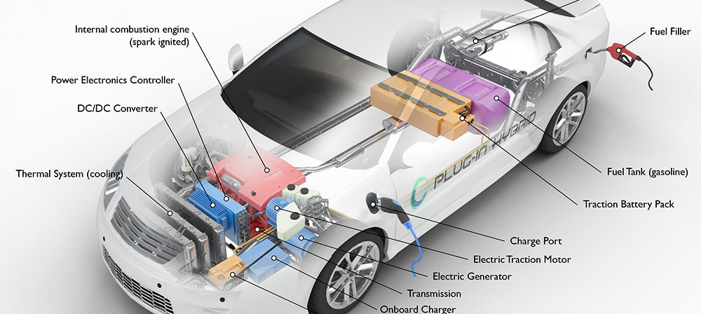
Level 1 & 2
The charging station is a safe appliance which provides AC current to an on-board battery charger, which then converts AC to the DC current necessary to charge the battery.

Slide 41
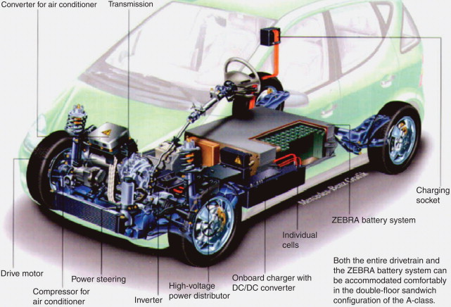
Level 3 / aka: DC Fast Charging
The DC Fast Charger converts AC current to the DC current necessary to charge the battery. It bypasses the on-board battery charger used for level 1 & 2 charging.

Slide 42
Residential Charging

Slide 43
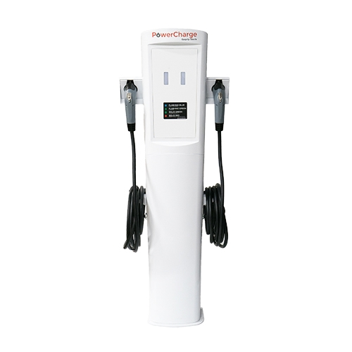
Typical Commercial Level 2 Charging Station
Common at workplace, public workplace & retail
240 volt with 15-to-80-amp power output
15 to 65 miles of range per hour of charge
Standard is 30-amp power output @ ~25 MRPH

Slide 44
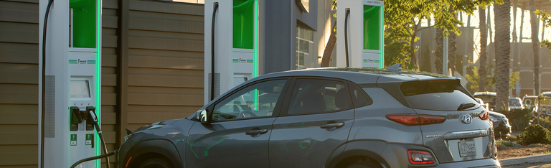
Level 3 Charging Station (aka: DC Fast Charger)
Usually found near highways & travel corridors
50kW to 350kW power output
200 to 1400 miles of range per hour of charge

Slide 45
Is there funding available for Electric Vehicles?
IRS Tax Credit (up to $7,500)
NYS Rebate (up to $2,000)

Slide 46
Is there funding available for Charging Stations?
IRS Tax Credit
Residential (30% up to $1,000)
Commercial (30% up to $30,000)
NYS Tax Credit
Commercial (50% up to $5,000)
NYSERDA Charge Ready Program
Commercial ($4,000 to $4,500 per charge port)
NYPA EV Make-Ready Program
Commercial (50% to 100% of installation cost)

Slide 47
What type of maintenance is required?
Tire rotation
Brake replacement
Tire replacement

Slide 48
Is electricity as a fuel cheaper than gas?
Hybrid and plug-in hybrid vehicles are about the same price as traditional cars, but cut emissions roughly in half.
Based on 1,000 miles driven, you pay around $33 a month to charge the average electric vehicle. That’s about $70 less than fueling up a comparable gas-powered vehicle.

Slide 49
Will the battery degrade over time?
Yes.
Consumer Reports estimates the average EV battery pack's lifespan to be at around 200,000 miles, which is nearly 17 years of use if driven 12,000 miles per year.
Most manufacturers place a 10-year warranty on the battery.

Slide 50
Questions?

